Slide 1
Chapter 10
Visual Imagery

Slide 2
What Is Imagery?
  Visual imagery: “seeing” in the absence of a visual stimulus
  Provides a way of thinking that adds another dimension to purely verbal techniques
  Mental imagery: experiencing a sensory impression in the absence of sensory input

Slide 3
Early Ideas About Imagery
  Imageless thought debate
  Is thinking possible without images?

Slide 4
Imagery and the Cognitive Revolution (1 of 2)
  Developed ways to measure behavior that could be used to infer cognitive processes
  Paired-associate learning

Slide 5
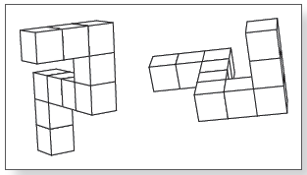
Imagery and the Cognitive Revolution (2 of 2)
  Paivio (1963, 1965)
  Memory for words that evoke mental images is better than for those that do not
  Conceptual peg hypothesis
  Shepard and Metzler (1971)
  Mental chronometry
  Participants mentally rotated one object to see if it matched another object
Notes:
(Source: Shepard & Metzler, 1971)

Slide 6
Imagery and Perception (1 of 5)
  Spatial correspondence between imagery and perception
  Mental scanning
  Participants create mental images and then scan them in their minds

Slide 7
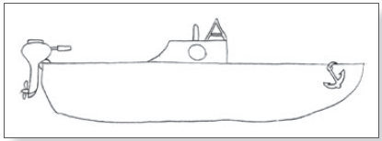
Imagery and Perception (2 of 5)
  Kosslyn (1973)
  Memorize picture and create an image of it
  In image, move from one part of the picture to the other
    It took longer for participants to mentally move long distances than shorter distances.
  Like perception, imagery is spatial.

Slide 8
Imagery and Perception (3 of 5)
  Lea (1975)
  More distractions when scanning longer distances may have increased the reaction time.
  Interesting things encountered during the mental scan are responsible for these distractions.

Slide 9
Imagery and Perception (4 of 5)
  Kosslyn and coworkers (1978)
  Island with seven locations, 21 trips
  It took longer to scan between greater distances.
  Visual imagery is spatial.

Slide 10
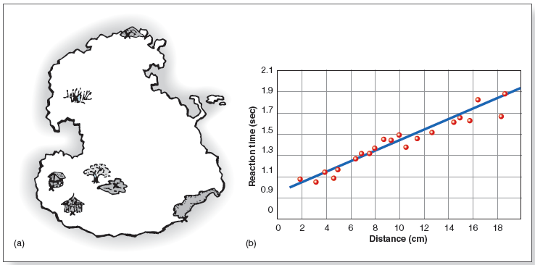
Imagery and Perception (5 of 5)
Notes:
Figure 10.4 (a) Island used in Kosslyn et al.’s (1978) image-scanning experiment. Participants mentally traveled between various locations on the island. (b) Results of the island experiment.

Slide 11
Is Imagery Spatial or Propositional? (1 of 2)
  Pylyshyn (1973)
  Spatial representation is an epiphenomenon.
    Accompanies real mechanism but is not actually a part of it
  Proposed that imagery is propositional.
    Can be represented by abstract symbols
  Imagery debate
    Propositional representation: symbols, language
    Depictive representation: similar to realistic pictures

Slide 12
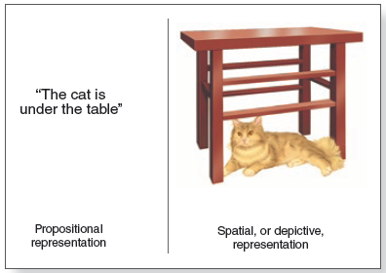
Is Imagery Spatial or Propositional? (2 of 2)
Notes:
Figure 10.5 Propositional and spatial, or depictive, representations of “The cat is under the table.”

Slide 13
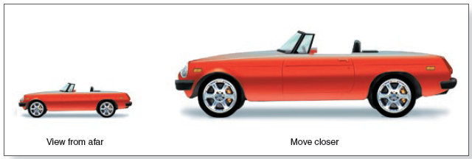
Comparing Imagery and Perception (1 of 3)
  Relationship between viewing distance and ability to perceive details
  Imagine small object next to large object
  Quicker to detect details on the larger object
Notes:
Figure 10.7 Moving closer to an object, such as this car, has two effects: (1) The object fills more of your visual field, and (2) details are easier to see.

Slide 14
Comparing Imagery and Perception (2 of 3)
  Mental walk task
  Move closer to small animals than to large animals
  Images are spatial, like perception

Slide 15
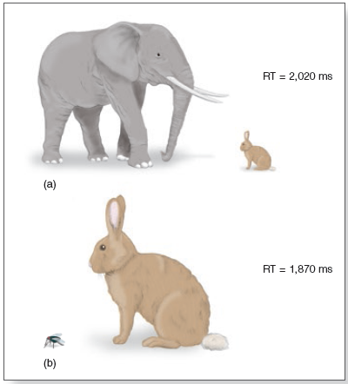
Notes:
Figure 10.8 These pictures represent images that Kosslyn’s (1978) participants created, which filled different portions of their visual field. (a) Imagine elephant and rabbit, so elephant fills the field. (b) Imagine rabbit and fly, so rabbit fills the field. Reaction times indicate how long it took participants to answer questions about the rabbit.

Slide 16
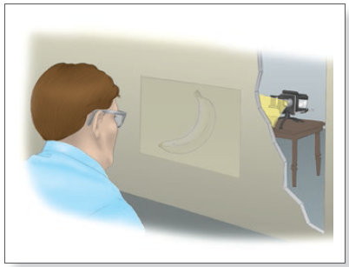
Interactions of Imagery and Perception (1 of 2)
  Perky (1910)
  Mistake actual picture for a mental image
Notes:
Figure 10.9 Participant in Perky’s (1910) experiment. Unbeknownst to the participants, Perky was projecting dim images onto the screen.

Slide 17
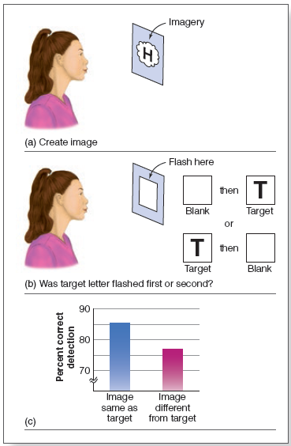
Interactions of Imagery and Perception (2 of 2)
Notes:
(Source: Farah, 1985) Figure 10.10 Procedure for Farah’s (1985) letter visualization experiment. (a) The participant visualizes H or T on the screen. (b) Then two squares flash, one after the other, on the same screen. As shown on the right, the target letter can be in the first square or in the second one. The participants’ task is to determine whether the test letter was flashed in the first square or in the second square. (c) Results showing that accuracy was higher when the letter in (b) was the same as the one that had been imagined in (a).

Slide 18
Imagery and the Brain (1 of 11)
  Imagery neurons respond to both perceiving and imagining an object
  Overlap in brain activation
  Visual cortex

Slide 19
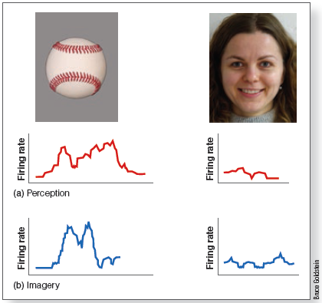
Imagery and the Brain (2 of 11)
Notes:
Figure 10.11 Responses of single neurons in a person’s medial temporal lobe that (a) respond to perception of a baseball but not of a face, and (b) respond to imagining a baseball but not to imagining a face.

Slide 20
Imagery and the Brain (3 of 11)
  Le Bihan et al.(1993)
  Overlap in brain activation
  Visual cortex

Slide 21
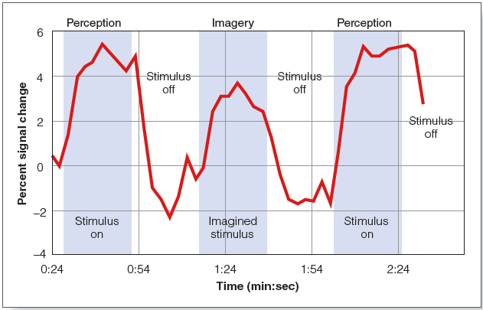
Imagery and the Brain (4 of 11)
Notes:
Figure 10.12 Results of Le Bihan et al.’s (1993) study measuring brain activity using fMRI. Activity increases to presentation of a visual stimulus (shaded area marked “Stimulus on”) and also increases when participants are imagining the stimulus (area marked “Imagined stimulus”). In contrast, activity is low when there is no actual or imagined stimulus.

Slide 22
Imagery and the Brain (5 of 11)
  Ganis et al. (2004)
  Complete overlap of activation by perception and imagery in front of the brain
  Differences near back of the brain

Slide 23
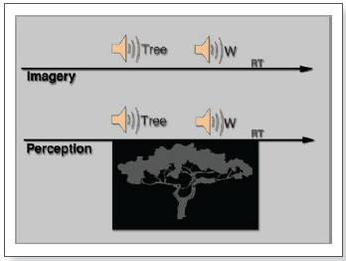
Imagery and the Brain (6 of 11)
Notes:
(Figure 10.14 Procedure for Ganis et al.’s (2004) experiment. A trial begins with the name of an object that was previously studied, in this case “tree.” In the imagery condition, participants had their eyes closed and had to imagine the tree. In the perception condition, participants saw a faint picture of the object. Participants then heard instructions. The W in this example means they were to judge whether the object was “wider than tall.”

Slide 24
Imagery and the Brain (7 of 11)
  Amedi et al. (2005)
  Again, overlap\
  Deactivation of nonvisual areas of brain
    Hearing
    Touch
  Mental images more fragile, less activation keeps other things from interfering

Slide 25
Imagery and the Brain (8 of 11)
  Brain activity in response to imagery
  May indicate something is happening
  May not cause imagery

Slide 26
Imagery and the Brain (9 of 11)
  Transcranial magnetic stimulation (TMS)
  Decreases brain functioning in a particular area of the brain for a short time
  If behavior is disrupted, the deactivated part of the brain is causing that behavior

Slide 27
Imagery and the Brain (10 of 11)
  Kosslyn and coworkers (1999)
  TMS to visual area of brain during perception and imagery task
  Response time slower for both
  Brain activity in visual area of brain plays a causal role for both perception and imagery

Slide 28
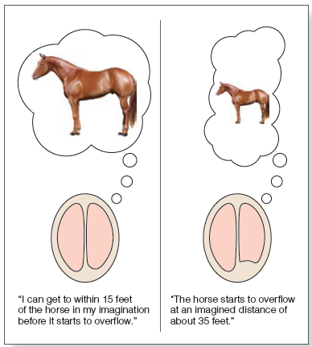
Imagery and the Brain (11 of 11)
Notes:
(Source: Farah, 2000) Figure 10.18 Results of the mental walk task for patient M.G.S. Left: Before her operation, she could mentally “walk” to within 15 feet before the image of the horse overflowed her visual field. Right: After removal of the right occipital lobe, the size of the visual field was reduced, and she could mentally approach only to within 35 feet of the horse before it overflowed her visual field.

Slide 29
Neuropsychological Case Studies
  Unilateral neglect
  Patient ignores objects in one half of visual field in perception and imagery

Slide 30
Dissociations Between Imagery and Perception (1 of 2)
  Guariglia et al. (1993)
  Brain-damaged patient
  Patient’s perceptions intact, but mental images were impaired

Slide 31
Dissociations Between Imagery and Perception (2 of 2)
  R.M.
  Damage to occipital and parietal lobes
  Could draw accurate pictures of objects in front of him
  Could not draw accurate pictures of objects from memory (using imagery)
  C.K.
  Inability to name pictures of objects, even his own drawings, in front of him
  Could draw objects in great detail from memory (using imagery)

Slide 32
Making Sense of Neuropsychological Results
  Evidence for a double dissociation between imagery and perception
  Indicates separate mechanisms
  Also evidence for shared mechanisms

Slide 33
Imagery and Perception (1 of 2)
  Differences in experience
  Perception is automatic and stable
  Imagery takes effort and is fragile

Slide 34
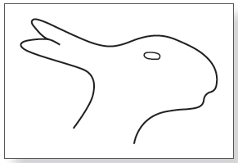
Imagery and Perception (2 of 2)
  Chalmers and Reisberg (1985)
  Had participants create mental images of ambiguous figures
  Difficult to flip from one perception to another while holding a mental image of it
Notes:
Figure 10.21 What is this, a rabbit (facing right) or a duck (facing left)?

Slide 35
Using Imagery to Improve Memory (1 of 2)
  Placing images at locations
  Method of loci
  Visualizing items to be remembered in different locations in a mental image of a spatial layout

Slide 36
Using Imagery to Improve Memory (2 of 2)
  Associating images with words
  Pegword technique
  Associate items to be remembered with concrete words
  Pair each of these things with a pegword
  Create a vivid image of things to be remembered with the object represented by the word

